Slide 1
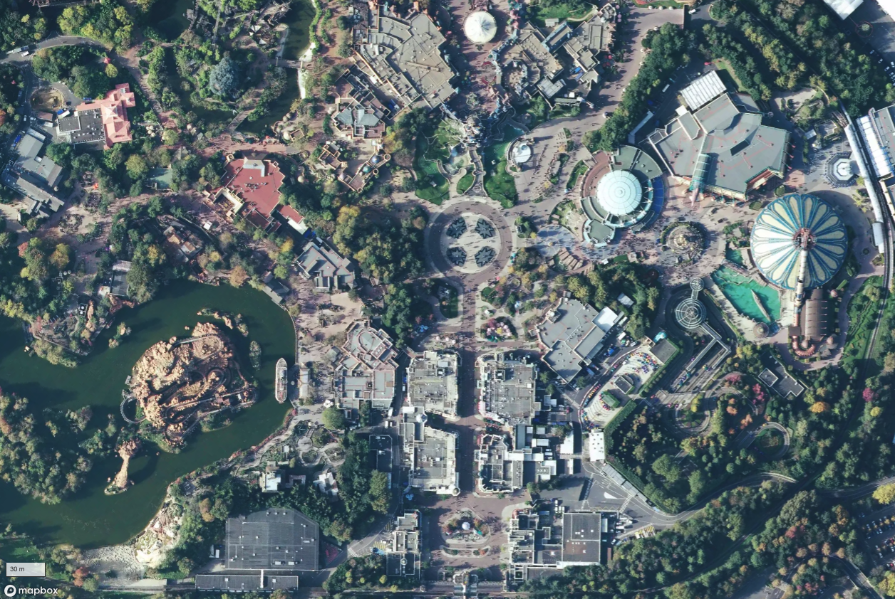

Project Members Diep Nguyen Harnil Patel Do Thin
Road Network Extraction From Satellite Imagery

Slide 2
INTRODUCTION
Objective
To develop a deep learning-based solution for semantic segmentation that can automatically identify and extract road networks from high-resolution satellite imagery.
Why It Matters
Accurate road maps are crucial for urban planning, navigation, disaster response, and autonomous driving.
Manual road annotation is time-consuming and costly.
Automating this process increases efficiency, scalability, and geospatial intelligence.

Slide 3
KEY TERMS TO REMEMBER
IoU (Intersection over Union) Measure the overlap between predicted and actual areas. The higher the IoU, the better the model's prediction.
ASPP (Atrous Spatial Pyramid Pooling) A technique used in DeepLabV3+ to capture features at multiple scales and improve segmentation accuracy, especially for roads of varying widths.
Dice Loss A function used to train models for image segmentation. It calculates the overlap between the predicted and actual pixels, helping the model make more accurate predictions.
DeepLabV3+ A deep learning model specifically designed for semantic segmentation tasks. It excels in extracting detailed and high-resolution features from images.

Slide 4
METHODOLOGY OVERVIEW
Use the DeepLabV3+ architecture with ResNet101 backbone.
Leverage Atrous Spatial Pyramid Pooling (ASPP) for capturing multiscale features.
Do preprocessing and augmentation using Albumentations.
Train on pixel-wise annotated images to predict binary road masks.
Do evaluation using IoU, Dice Loss, and visual inspection of predictions.

Slide 5
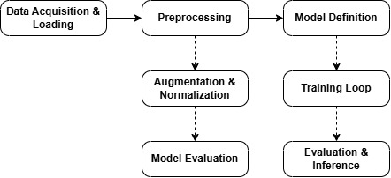
PROJECT BLOCK DIAGRAM

Slide 6
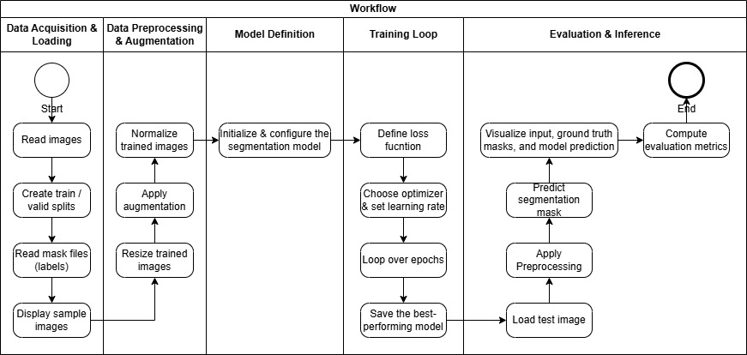
PROJECT FLOWCHART

Slide 7
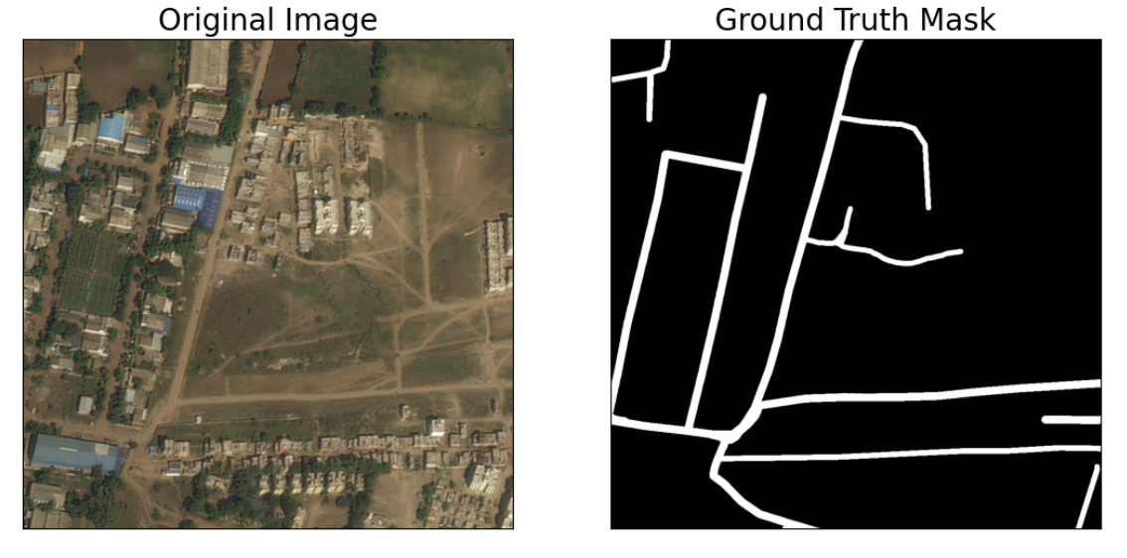
DATASET OVERVIEW
Acknowledgement
This dataset was obtained from Road Extraction Challenge Track in DeepGlobe Challenge . For more details on the dataset refer the related publication - DeepGlobe 2018: A Challenge to Parse the Earth through Satellite Images
Cite: “ https://doi.org/10.48550/arXiv.1805.06561 “
Data
The training data for Road Challenge contains 6226 satellite imagery.
The imagery has 50cm pixel resolution, collected by DigitalGlobe's satellite.
The dataset contains 1243 validation and 1101 test images (but no masks).
To download data : “ https://www.kaggle.com/datasets/balraj98/deepglobe-road-extraction-dataset/data “

Slide 8
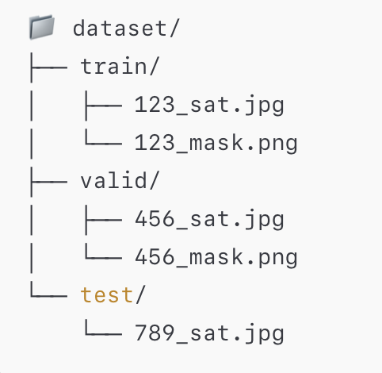
DATA ACQUISITION AND LOADING
Dataset Split
The dataset is split into training and validation sets.
Split used: 90% training / 10% validation.
Code Segment
#Perform 90/10 split for train / val
valid_df = metadata_df.sample (frac=0.1, random_state=42)
train_df = metadata_df.drop(valid_df.index)
len (train_df), len(valid_df)

Slide 9
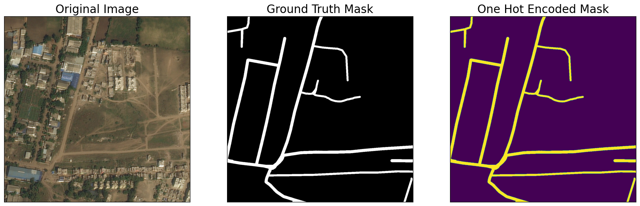
DATA PRE-PROCESSING AND ARGUMENTATION
Description
Convert image to tensor
Normalize based on ImageNet stats
Resize or augment (for training only)
Code Segment(Pre-Processing)
def get_preprocessing(preprocessing_fn):
"""Construct preprocessing transform using Albumentations"""
return A.Compose ([
A.Lambda(image=preprocessing_fn),
A.Lambda(image=to_tensor, mask=to_tensor) ,
])
Code Segment(Argumentation):
def get_training_augmentation():
train_transform = [
album.HorizontalFlip(p=0.5),
album.VerticalFlip(p=0.5),
]
return album.Compose(train_transform)

Slide 10
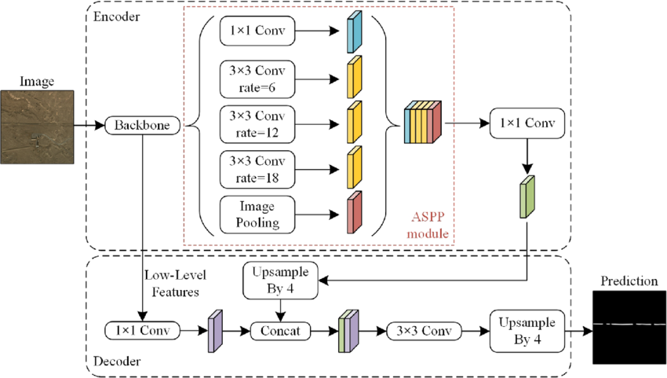
MODEL DEFINITION AND ARCHITECTURE
Code Segment:
ENCODER = 'resnet101'
ENCODER_WEIGHTS = 'imagenet'
CLASSES = select_classes
ACTIVATION = ‘sigmoid’
model = smp.DeepLabV3Plus(
encoder_name=ENCODER,
encoder_weights=ENCODER_WEIGHTS,
classes=len(CLASSES),
activation=ACTIVATION,
)
Description
Use segmentation_models_pytorch
Model: DeepLabV3Plus
Encoder: Resnet101
Backbone: Extract rich hierarchical features from input images.
ASPP Module: Recognize road structures of varying widths.
Output Layer: A 1x1 convolution followed by a sigmoid activation outputs the binary segmentation map.

Slide 11
MODEL CONFIGURATION AND TRAINING SETUP
Code Segments:
Hyperparameters and Setup:
EPOCHS = 5
DEVICE = torch.device("cuda" if torch.cuda.is_available() else "cpu")
Loss, Metrics, Optimizer:
loss = smp.utils.losses.DiceLoss()
metrics = [smp.utils.metrics.IoU(threshold=0.5)]
optimizer = torch.optim.Adam([dict(params=model.parameters(), lr=0.00008)])
Epoch Setup:
train_epoch = smp.utils.train.TrainEpoch(...)
valid_epoch = smp.utils.train.ValidEpoch(...)
Training Loop:
for i in range(0, EPOCHS):
train_logs = train_epoch.run(train_loader)
valid_logs = valid_epoch.run(valid_loader)
if best_iou_score < valid_logs['iou_score']:
best_iou_score = valid_logs['iou_score']
torch.save(model, './best_model.pth')
print('Model saved!')

Slide 12
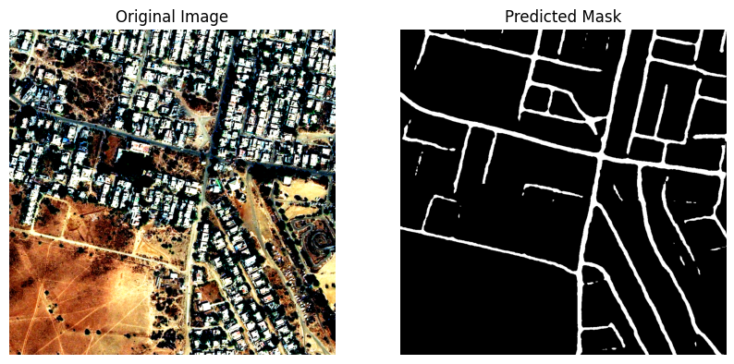

MODEL EVALUATION
Description
The evaluation includes metrics such as
IoU Score (Intersection over Union)
Dice Loss
Output Segment
valid: 100%|██████████| 623/623 [02:05<00:00, 4.96it/s, dice_loss - 0.02064, iou_score - 0.961] Evaluation on 10% Validation Data: Mean IoU Score: 0.9610 Mean Dice Loss: 0.0206

Slide 13
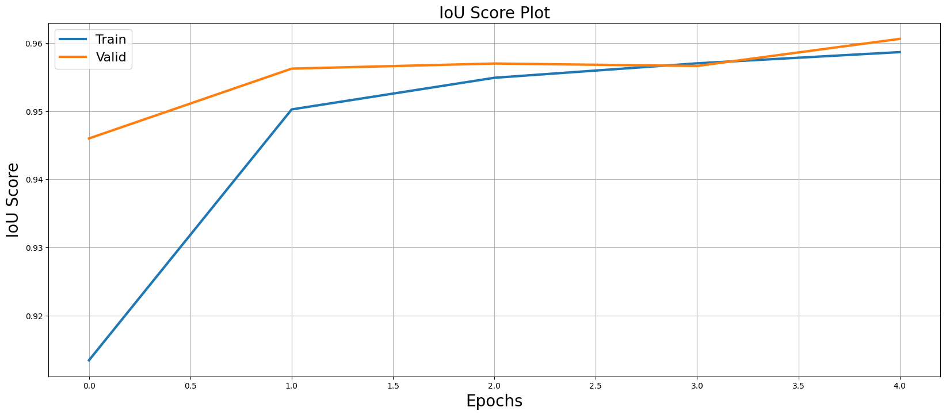
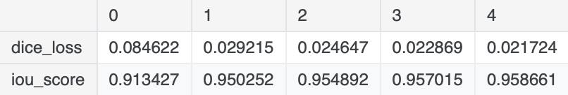
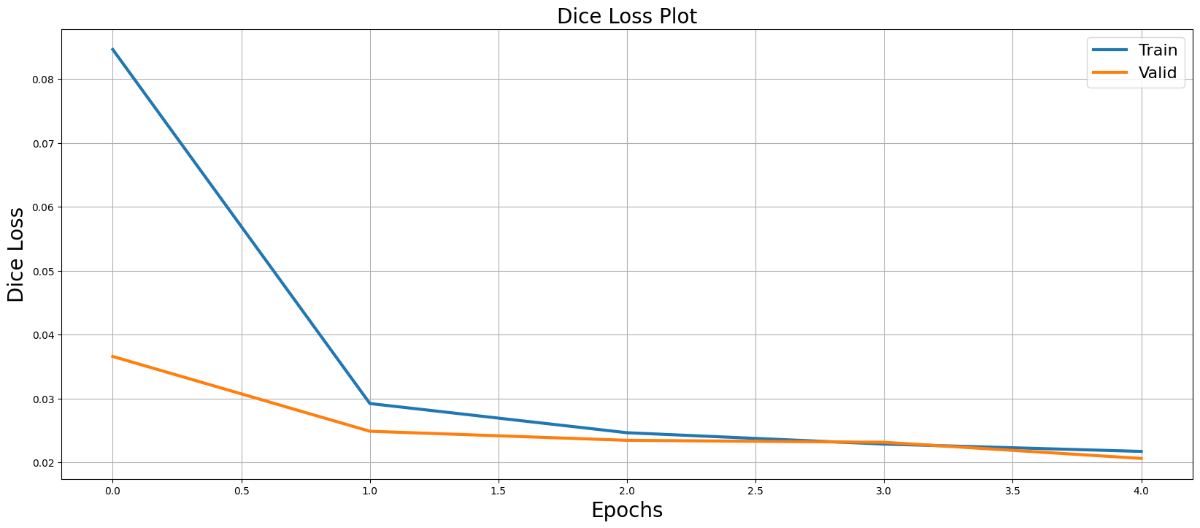
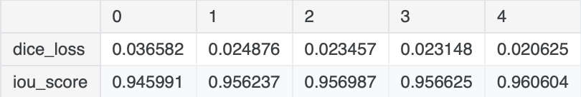
Dice Loss/ IoU Logs
Interpretation:
The model performed very well, with a high IoU score (96.1%) and a low Dice loss (2.06%) on the data set.
Train logs
Valid logs

Slide 14
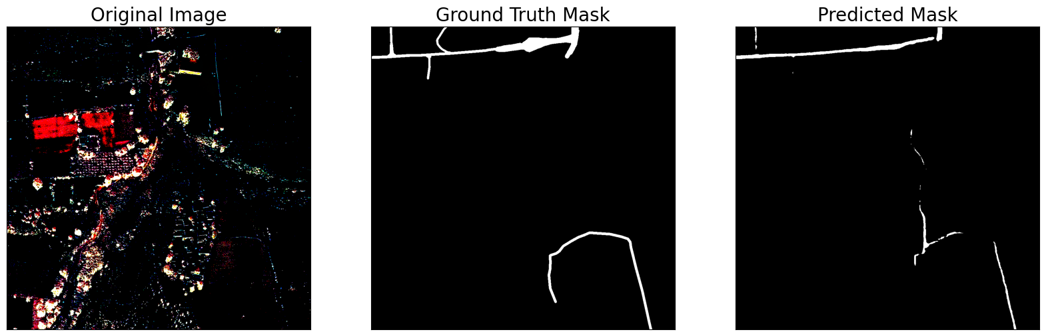
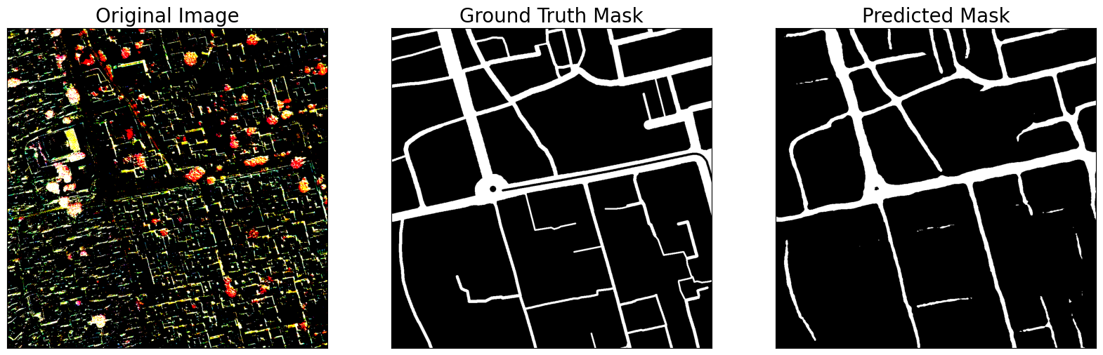
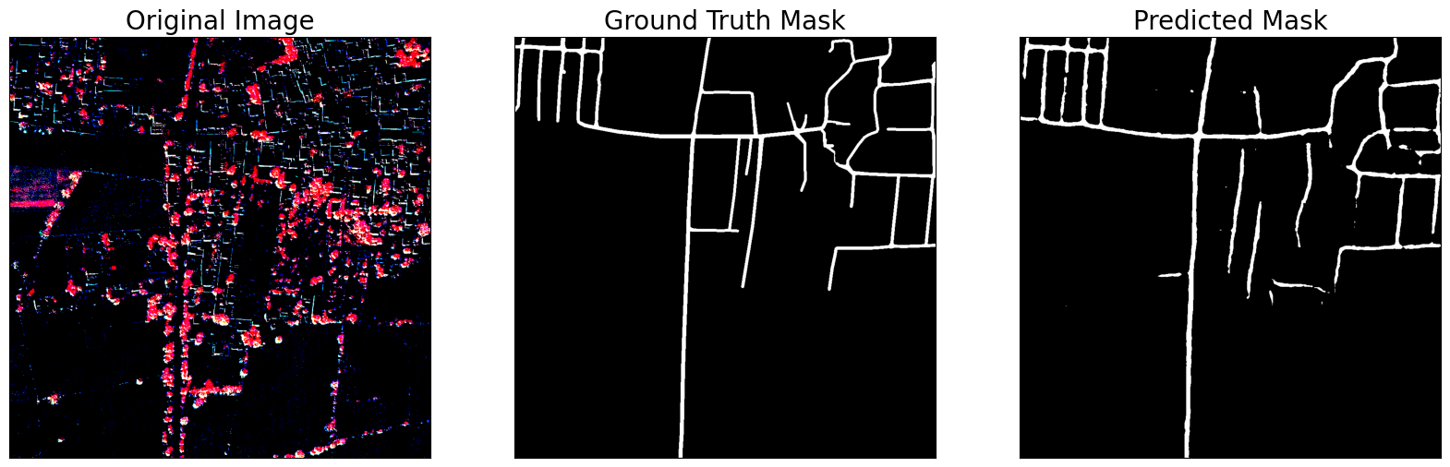
TRUTH MASK VS PREDICTED MASK
Description
Evaluate the model's prediction quality by comparing its output to the actual ground truth.
Ground Truth Mask: Manually annotated mask showing the actual road network.
Predicted Mask: Output from the trained DeepLabV3+ model.

Slide 15
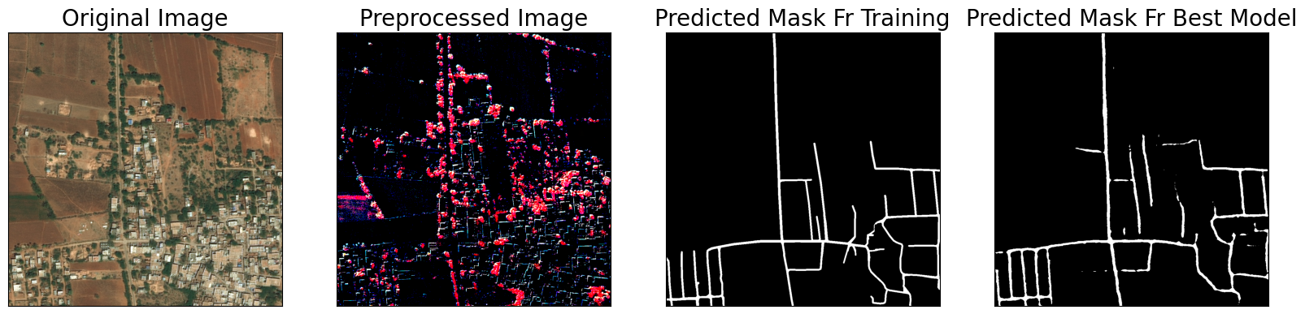
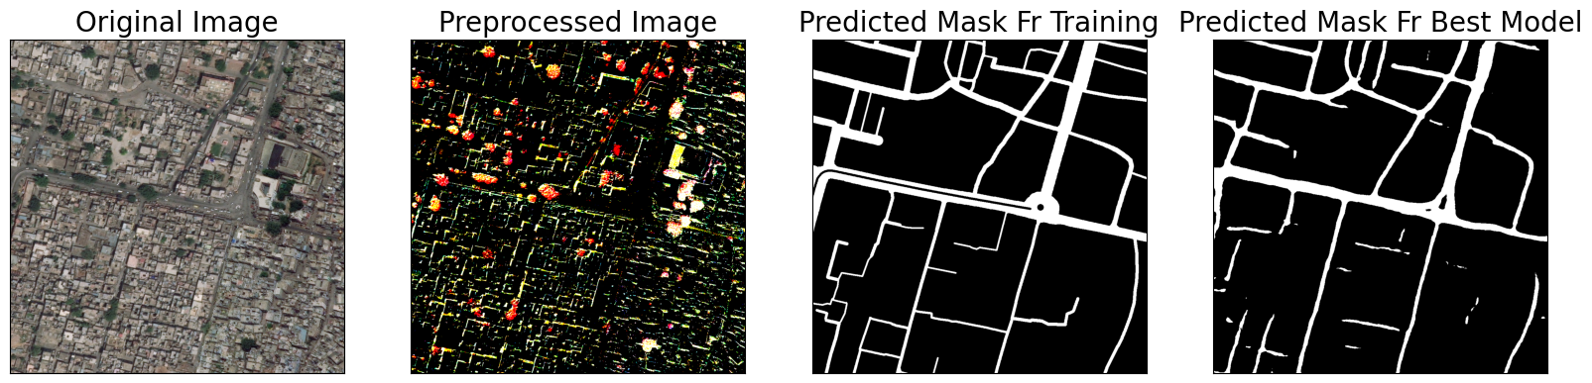
MODEL PREDICTION COMPARISION
Description
The model's output showed the progression from early training stages to the best-performing version (Without ground truth mask).

Slide 16
COMPARISION BETWEEN U-NET AND DEEPLABV3
Loss Comparison:
Both U-Net and DeepLabV3+ has the low loss with 0.0658 and 0.0206 respectively but DeepLabV3+ is better because it’s able to capture the road regions well and overlap with the ground truth effectively.
Model Preference:
If your goal is high precision in road segmentation, DeepLabV3+ with its high IoU score would likely give more accurate road boundaries, even for thin or fragmented roads.
U-Net performs well in terms of accuracy and might be preferred if real-time inference speed or less complexity is needed, especially if you want to deploy the model with fewer computational resources.

Slide 17
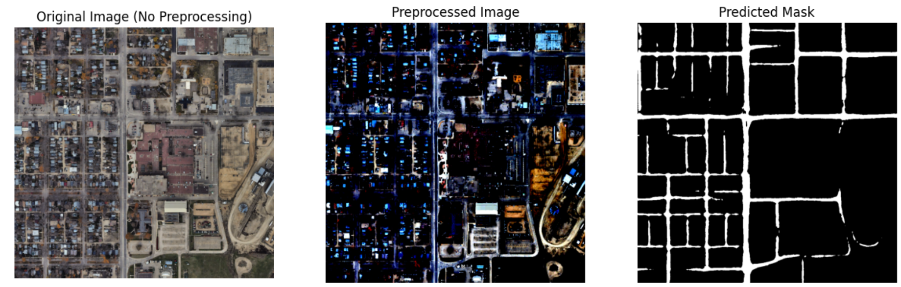
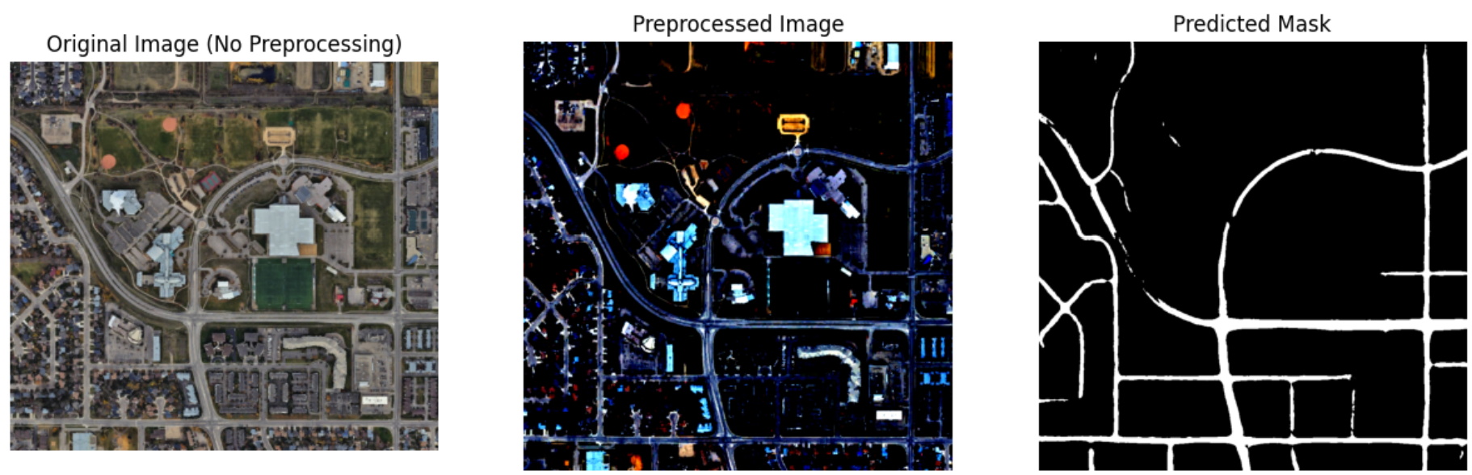
PROJECT REAL DEMO
https://www.kaggle.com/code/capstoneprojectaida/demo-notebook-ai-road-network-extr-06c021

Slide 18
FUTURE SCOPE
Expand the Dataset for Greater Diversity
A more diverse dataset would improve the model’s gereralization and adaptability in real-world applications: more geographical regions, seasonal variations, and edge case (eg., dirt roads, mountianous areas).
Real-Time Road Segmentation on Edge Devices
Deploy the model to work on mobile devices or drones with limited computational power.
Use model optimization techniques like quantization, pruning, and knowledge distillation to reduce model size and inference time for real-time segmentation on edge devices.
Deployment on Cloud Platforms
Host the model on cloud platforms (e.g., AWS, Azure, Google Cloud) for scalable road segmentation that can process large datasets or real-time video streams.
Implement an API to allow users to upload images and get road segmentation results via a web interface.

Slide 19
REFERENCES
Liu, Y., Guo, Y., Zhang, F., & Wang, X. (2024). A Novel Network Framework on Simultaneous Road Segmentation and Vehicle Detection for UAV Aerial Traffic Images. Sensors, 24(11), 3606.
Mnih, V., & Hinton, G. (2018). "Learning to Detect Roads in High-Resolution Aerial Images." Neural Information Processing Systems (NeurIPS).
Sun, H., Wu, Y., & Zhang, J. (2021). "Improved Satellite Road Extraction Using DeepLabV3+ with Attention Mechanisms." IEEE Geoscience and Remote Sensing Letters.
Bahrampour, S., Ramakrishnan, N., Schott, L., & Shah, M. (2015). Comparative Study of Deep Learning Software Frameworks. arXiv preprint arXiv:1511.

Slide 20

THANK YOU

